Slide 1
Access Updates
SQL Server with Access
Michal Bar
Program Manager, Microsoft

Slide 2
Current State

Slide 3
Access in O365 and Office 2019
O365
Office 2019
Subscription service that ensures you always have the most up-to-date modern productivity tools from Microsoft
A one-time purchase, which means you pay a single, up-front cost to get Office apps for one computer. No upgrade options are available.
Access
Monthly updates including bug fixes and new features
- Linked Table Manager
- Modern charts
- Everything on our roadmap
Access
Security updates only
- Modern charts
Learn more

Slide 4
Linked Table Manager

Slide 5
What did we learn from customers?
LINKED TABLE MANAGER
Functionality
Usability
Add New Link
Delete Link
Relink a connection to a new data source
Missing dev to prod scenario support
Bulk rename
Resize window
Multiple prompts (when refreshing multiple tables of the same data source)
Flat view
Status indication

Slide 6
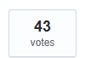
From UserVoice
https://access.uservoice.com
“Skip tables with errors and continue linking with all in the list”
“One of the biggest pains is when you have multiple back ends and Linked Table Manager (LTM) prompts you at every table. When you have lots of links and multiple back ends, it's a pain to go through and select all from only one back end.”
“It becomes difficult to identify the source of a table when using multiple databases as a backend”
“it would be even nicer if this dialog box was sizeable -- and even better if the size can be remembered!”

Slide 7
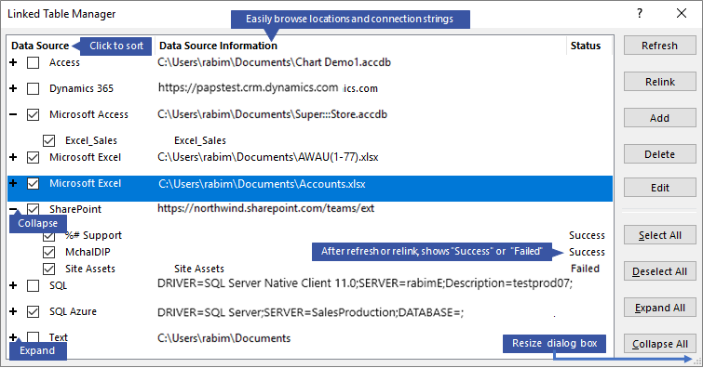

Slide 8
Demo

Slide 9
Modern Charts

Slide 10
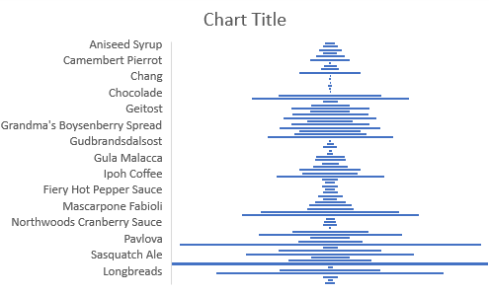
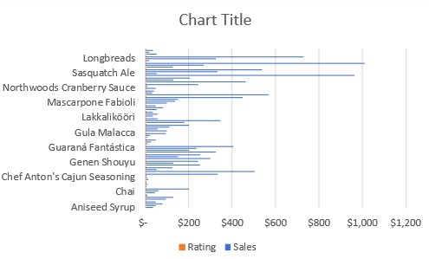
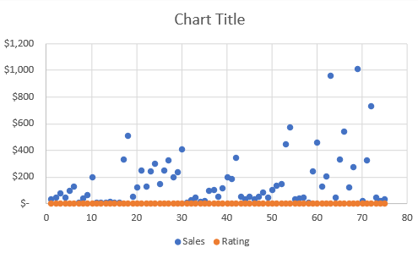
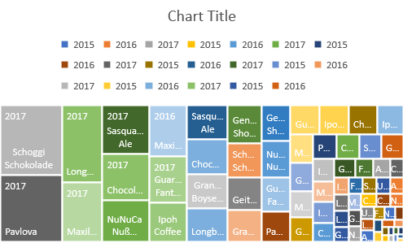
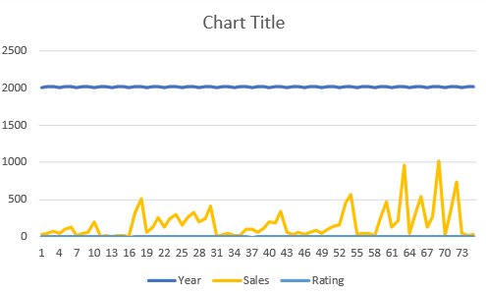
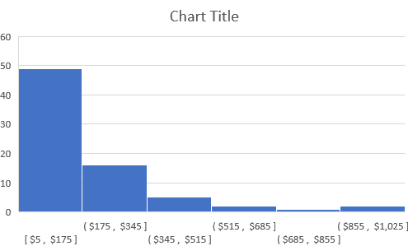
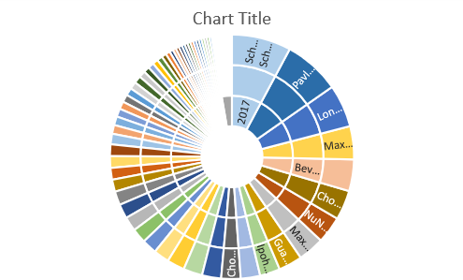
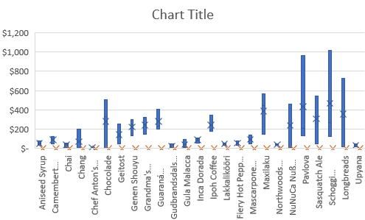
MODERN CHARTS
Help people understand the significance of data by placing it in a visual context

Slide 11
What did we learn from customers?
MODERN CHARTS
Key scenario
Selling Point
PivotCharts
Current and Modern
Design Experience
Export to Excel

Slide 12
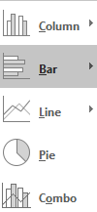
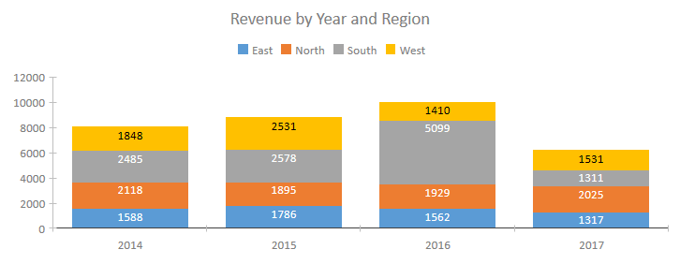
MODERN CHARTS
New modern charts
Modern look and feel
Friendly user experience
Interactive charts

Slide 13
Learn more
Create a chart on a form or report
Ignite presentation and demo

Slide 14
Roadmap

Slide 15
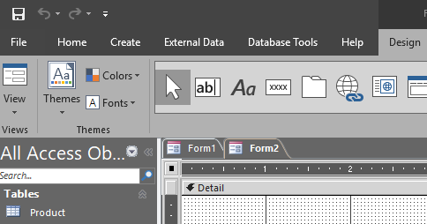
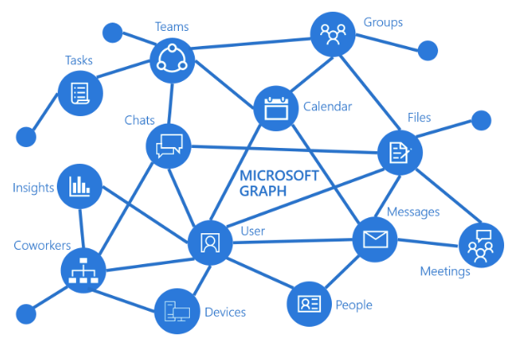
On the horizon
ROADMAP
Black and Dark Gray themes support
Connect to Microsoft Graph
O365 public roadmap https://products.office.com/business/office-365-roadmap

Slide 16
Community engagement

Slide 17
COMMUNITY ENGAGEMENT
RESPOND TO FEEDBACK
PRODUCT TEAM VISIBILITY
CUSTOMER CONNECTION
EVENTS PRESENCE
In app feedback
User Voice
O365 public roadmap
Access Blog
Customer visits and interviews
Users group speaking
Conferences/Access Days

Slide 18
Q & A

